Slide 1
xBGAS Group Meeting
Xi Wang
11.02.2017

Slide 2
Updates:
Create a repo in the GitLab for extended RISCV LLVM compiler.
Edit the RISCVAsmParser to support the extended registers
Updates the RISCVInstrFormats.td to support 3 added instruction types.
Update the Register Name from BR->ER
Create a new target processor for the xBGAS extionsion in RISCV.td

Slide 3
Updates:
Fix the bugs in the opcodes encoding, the instruction definition, etc.
Write test bench that includes all the added registers and instructions.
Study the FileCheck and llvm-mc for the testing.
Study and build the llvm-lit for automating the tests.
Now, it seems that everything looks alright.

Slide 4
Repo
As I am not a upgraded user of Github, I cannot create a private repo for the extended LLVM compiler.
So, I temporarily created a repo in the our Gitlab server: http://discl.cs.ttu.edu/gitlab/xiwang/xbgas-llvm.git

Slide 5
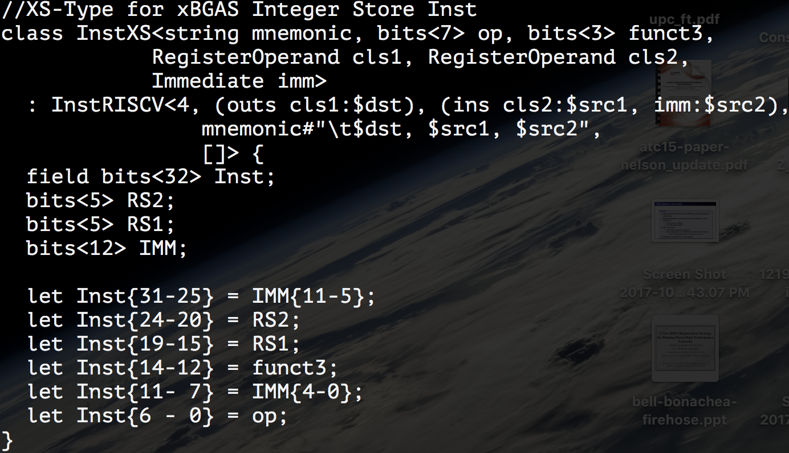
RISCV Instruction formats

Slide 6
Test Bench
Test file: valid-xBGAS.s is in: /riscv-llvm/test/MC/RISCV/EXT-X
Demo

Slide 7
Question
RDMA Advantages
Zero-copy - Data is sent and received directly to the buffers without being copied between the network layers.
Kernel bypass - Data transfers directly from user-space without kernel involvement.
No CPU involvement - applications can access remote memory without consuming any CPU time in the remote server.

Slide 8
Question
RDMA Disadvantages
Polling - Target node is not notified of the completion of the request (1-sided communications).
Page Pinning - RDMA protocols require that the memory pages involved in a transaction be pinned.

Slide 9
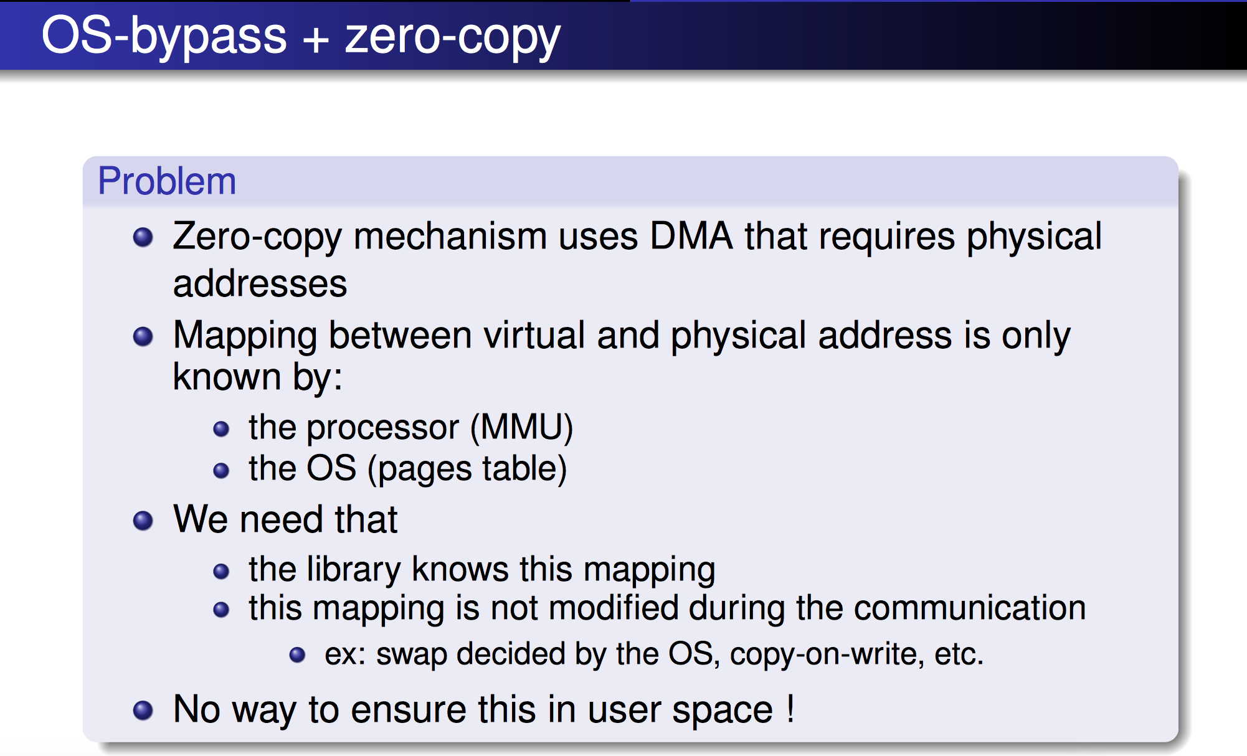

Slide 10
